Slide 1

CMPE 274 Business intelligence
Project Presentation
Team 6

Slide 2




Team Details
Mounica Reddy Kandi
016021902
mounicareddy.kandi@sjsu.edu
4083872864
Niranjan Reddy Masapeta
015748122
niranjanreddy.masapeta@sjsu.edu
9165409975
Preethi Billa
015920411
preethi.billa@sjsu.edu
4085494116
Pavan Karthik Gollakaram
015945670
pavankarthik.gollakaram@sjsu.edu
4084621091

Slide 3
Crime Data Analysis
Detailed analysis on the dataset containing crime related data in San Francisco Bay area.​
Dataset: https://data.world/data-society/san-francisco-crime-data​
Crime data ranges from 2003 to 2015 with details such as timestamp of crime, address including latitude and longitude, category of the crime and resolution as well.​
Analysis using flagship BI tool Tableau for detailed statistics.​
Tools: Python, Jupyter Notebook, Tableau

Slide 4
Project Deliverables
Data Visualizations and Analysis on given data set to gain further insights in the data.
Hands-on with Jupyter Notebook for tasks such as Exploratory Data Analysis (EDA) and Data Visualizations.
BI using Tableau for individual visualizations and single dashboard

Slide 5
Tech Stack
Python
Jupyter Notebook
Pandas
Seaborn
Folium
Tableau Public

Slide 6
Dataset
This is an incident dataset derived from the SFPD Crime Incident Reporting system​.
Source: https://data.world/data-society/san-francisco-crime-data
The dataset, with 800,000 records originally derived from the SFPD Crime Incident Reporting System, consists detailed information about each incident.
The dataset range is from 1st January 2003 to 15th March 2015.

Slide 7
Dataset Description
Date – Incident’s date is mentioned here in a standardized format to avoid any further complications.
Category – Clear distinctions according to the laws are made to avoid redundancy.
Descript – The PD verbatim of each case is digitalized as well.
DayOfWeek – This information helps in determining the weekday vs weekend security risks. The similarities and the differences as well.
PdDistrict – The district area in which the crime has taken place.
Address – The precise address in the standardized format is recorded.
X (Longitude) – To further augment the accuracy of the location, precise longitude numbers are included as well.
Y (Latitude) - To further augment the accuracy of the location, precise latitude numbers are included as well.

Slide 8
Functional Requirements
Find patterns to track different crimes depending on areas of interest and time.
Visualize and categorize crimes based on their features given in the data to study more about criminal behavior.
User available dashboard for active vigilance.
Interactive map for identifying high risk areas based on crime and resolution

Slide 9
Non-Functional Requirements
Exploratory Data Analysis using Jupyter Notebook for Data preprocessing.
Dashboard with visualizations of the given data using Tableau.

Slide 10
User Scenario
Crime department uses our dashboard for future possible crime predictions to prevent them in advance. Dashboard also helps in maintaining securities in areas of high crime activity.
Public users might access few sections of the dashboard to stay vigilant in the areas of high criminal activity.

Slide 11
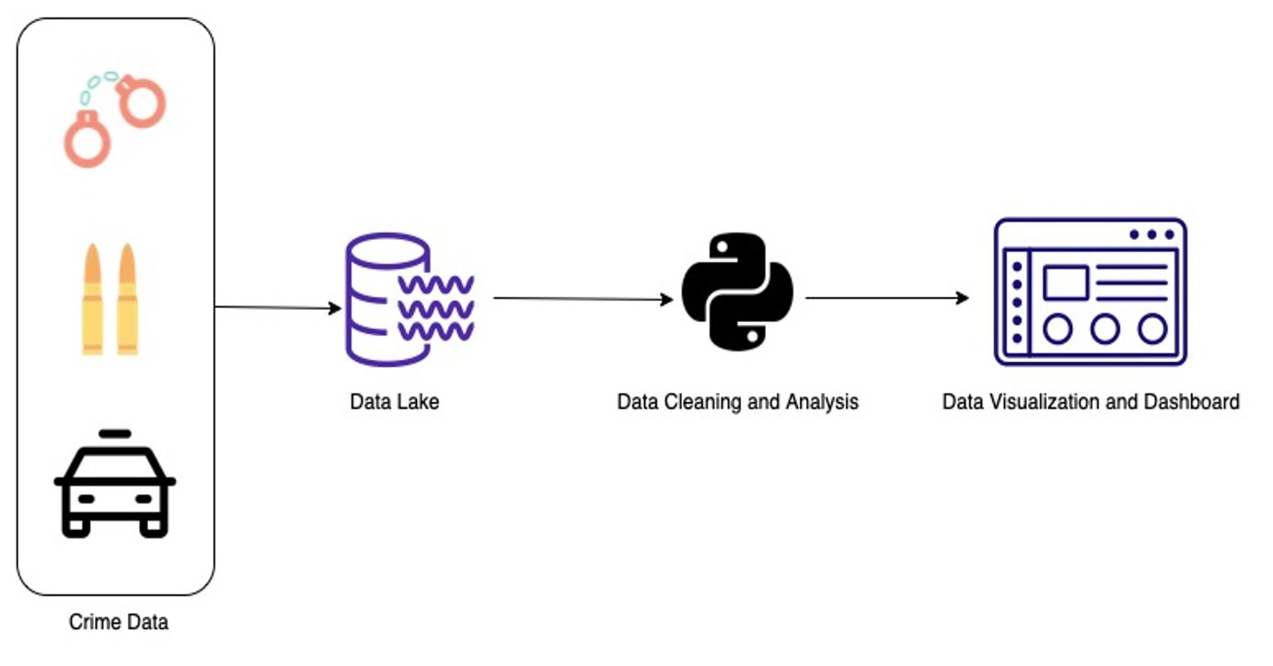
Project Architecture

Slide 12
Project Architecture
Crime Data: Dataset containing all crime related data
Data Lake: You can store all your structured and unstructured data in a data lake, which is a centralized repository that works at any scale. You can use data source in Tableau for using it to build dashboard.
Data Cleaning and Analysis: Data cleaning and analysis steps to preprocess and prepare the data for data visualizations.
Data Visualization and Dashboard: Leveraging both Jupyter Notebook and Tableau, we visualize the required data trends. Maps, boxplots, pie charts, tree maps are all generated.

Slide 13
System Design Flow
Data Cleaning
Missing Values
Outlier detection
Handling impurities
Data Processing
Feature extraction
Feature engineering
Data Visualizations
Bar graphs
Pie charts
Tree maps
Dashboard

Slide 14
Performance metrics
Accurate data visualizations offering simple and easy to comprehend the analytics
Interactive map for easy-to-use UI and ease of information access
Data observations to know more about criminal behaviour
Useful dashboard for all-in-one visualizations.

Slide 15

Data Visualizations Jupyter Notebook

Slide 16
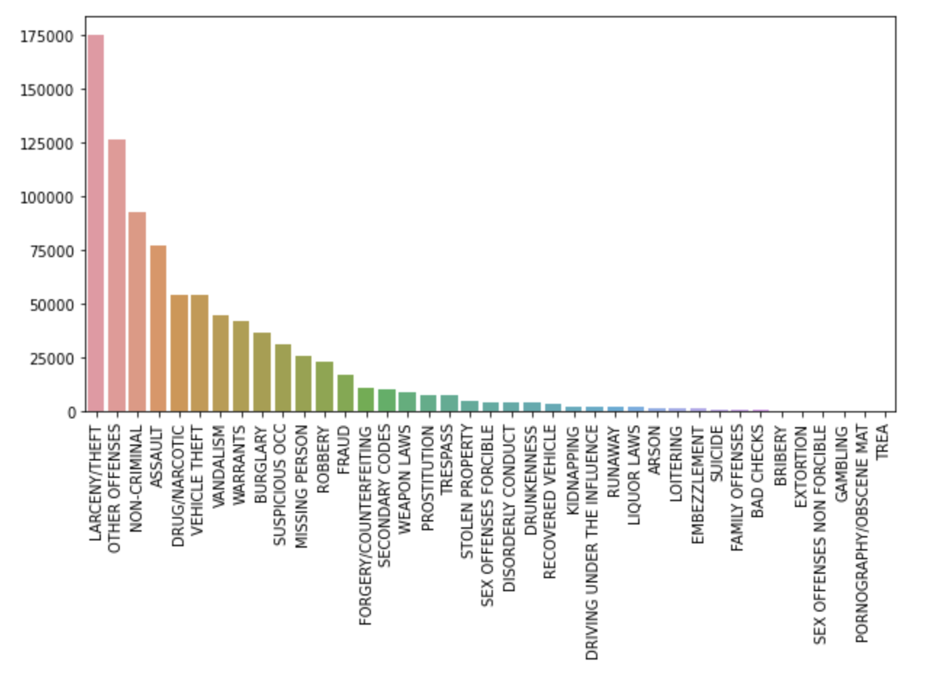
Bar plot showing the count of crimes filtered by category of crimes

Slide 17
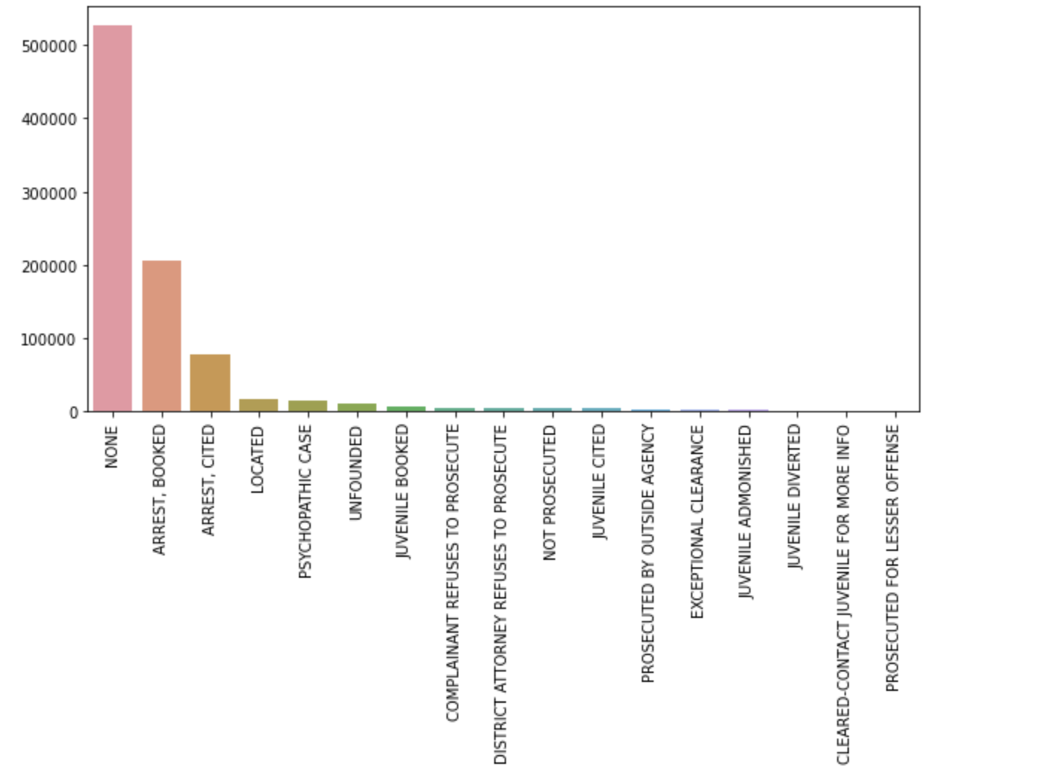
Bar plot showing the count of crimes filtered by resolution for the crimes

Slide 18
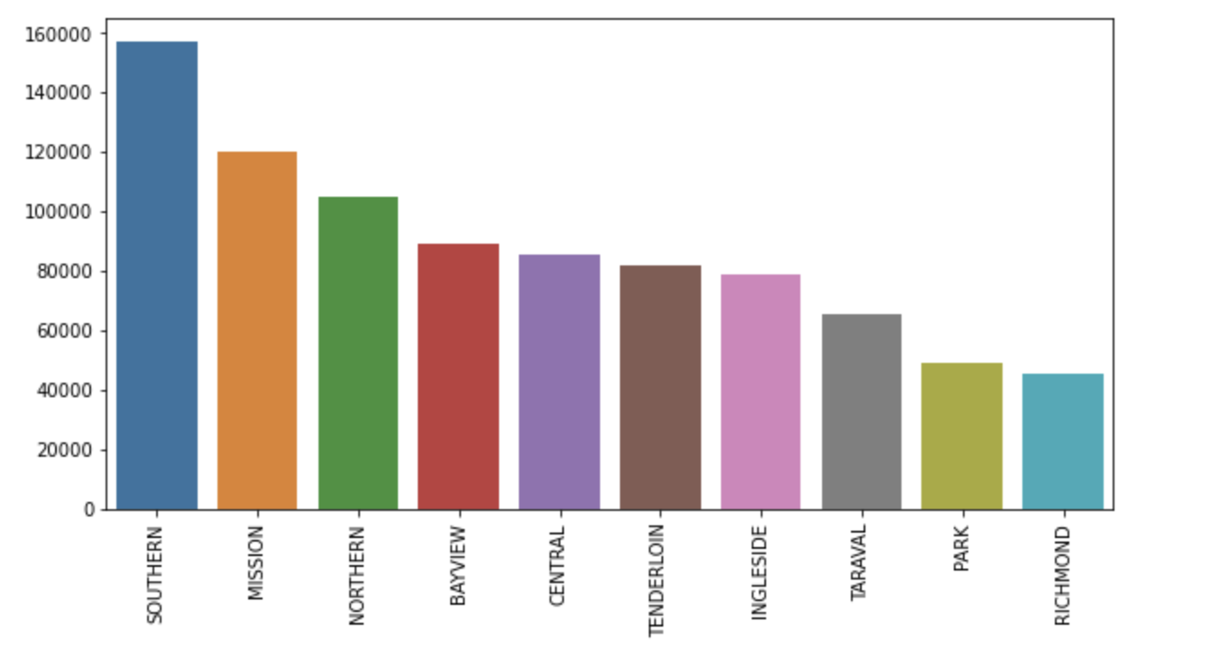
Bar plot showing the count of crimes filtered by district where crimes happened

Slide 19
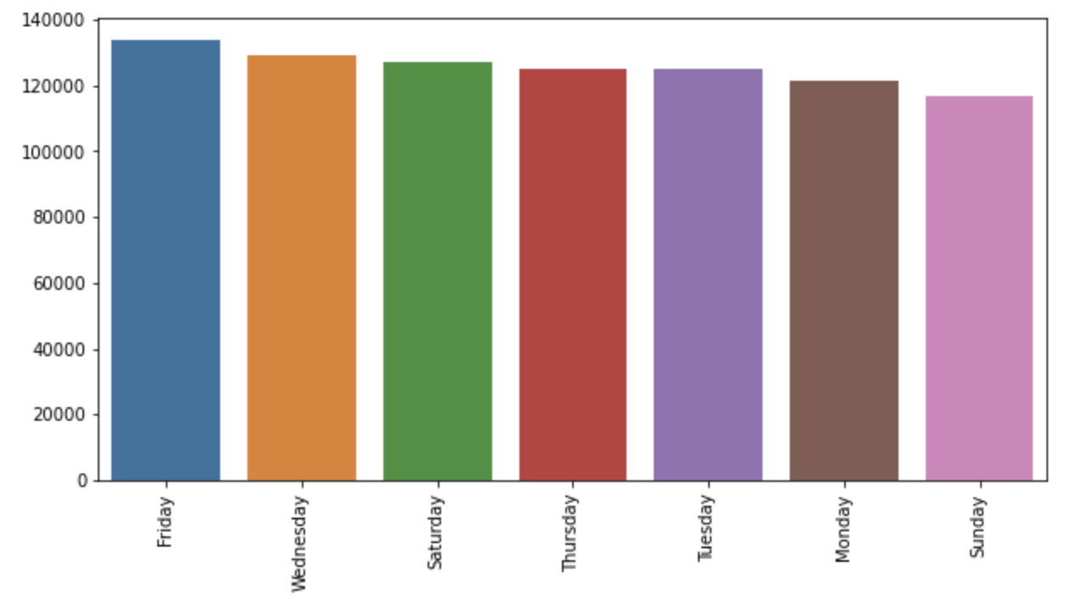
Bar plot showing the count of crimes filtered by day of the week the crime happened

Slide 20
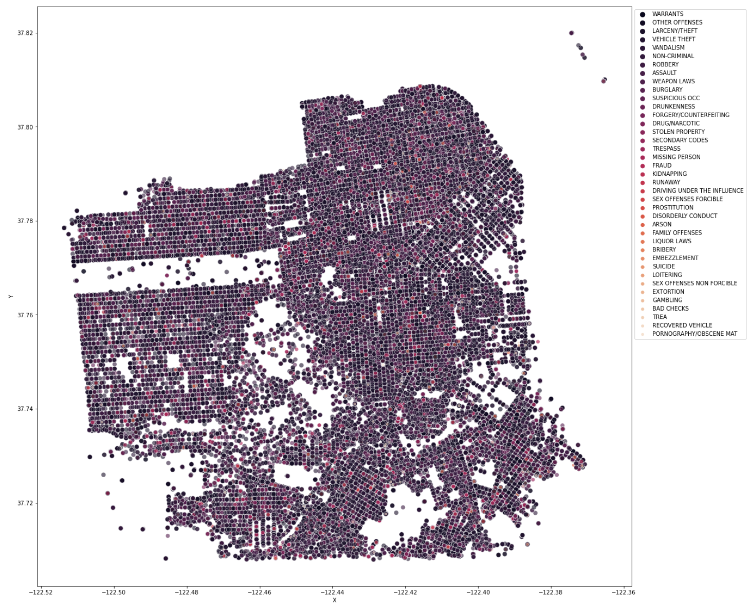
Scatterplot showing the map of San Francisco filtered by category of crimes

Slide 21
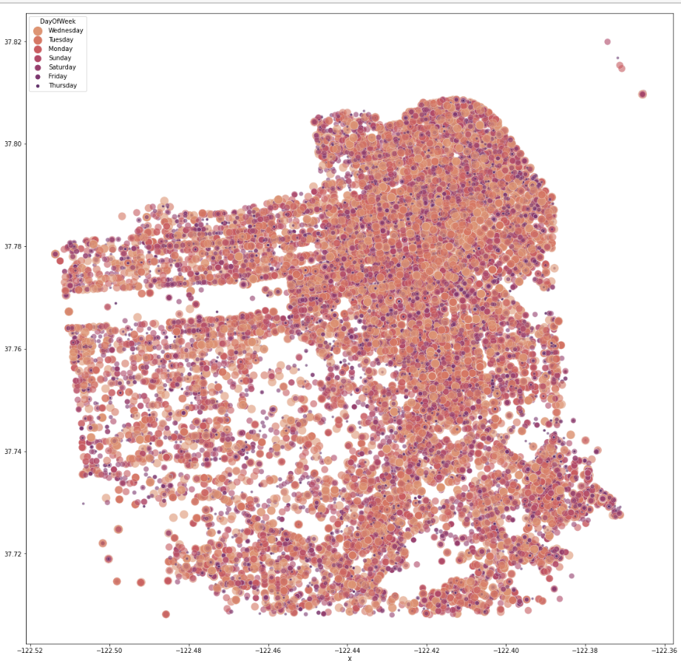
Scatterplot showing the map of San Francisco filtered by day of the week the crime happened

Slide 22
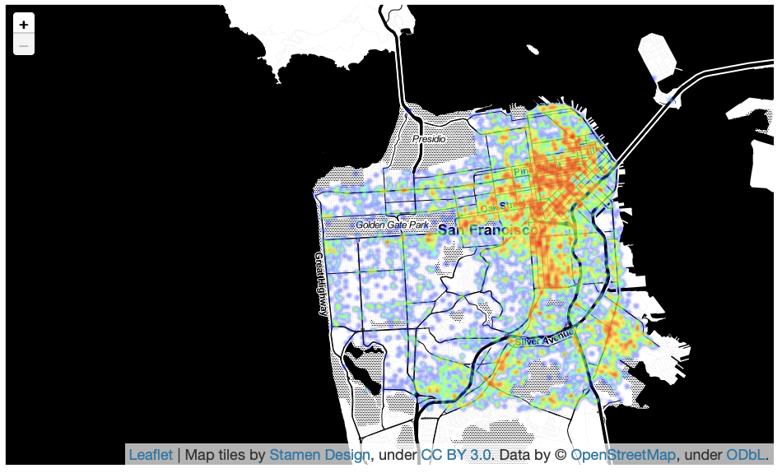
Interactive Map using Folium package filtered by Category and Resolution

Slide 23
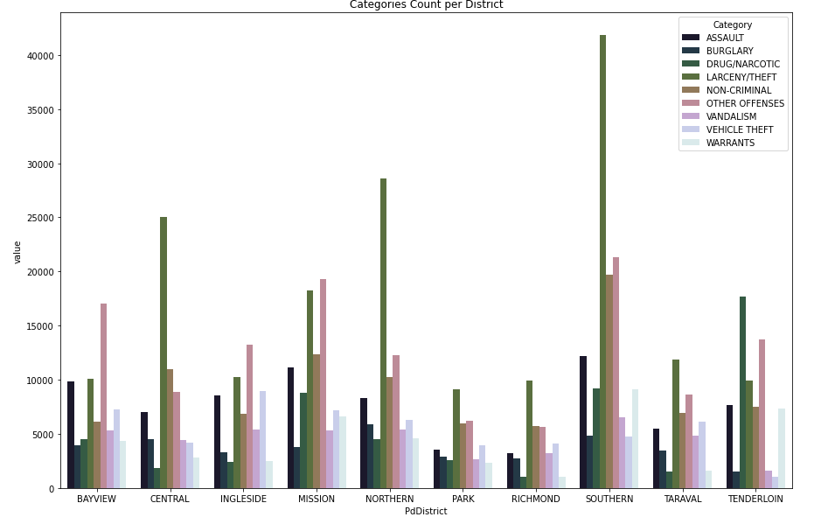
Bar plot showing the count of crimes filtered by Categories Count per District

Slide 24
Data Visualizations Tableau Public

Slide 25
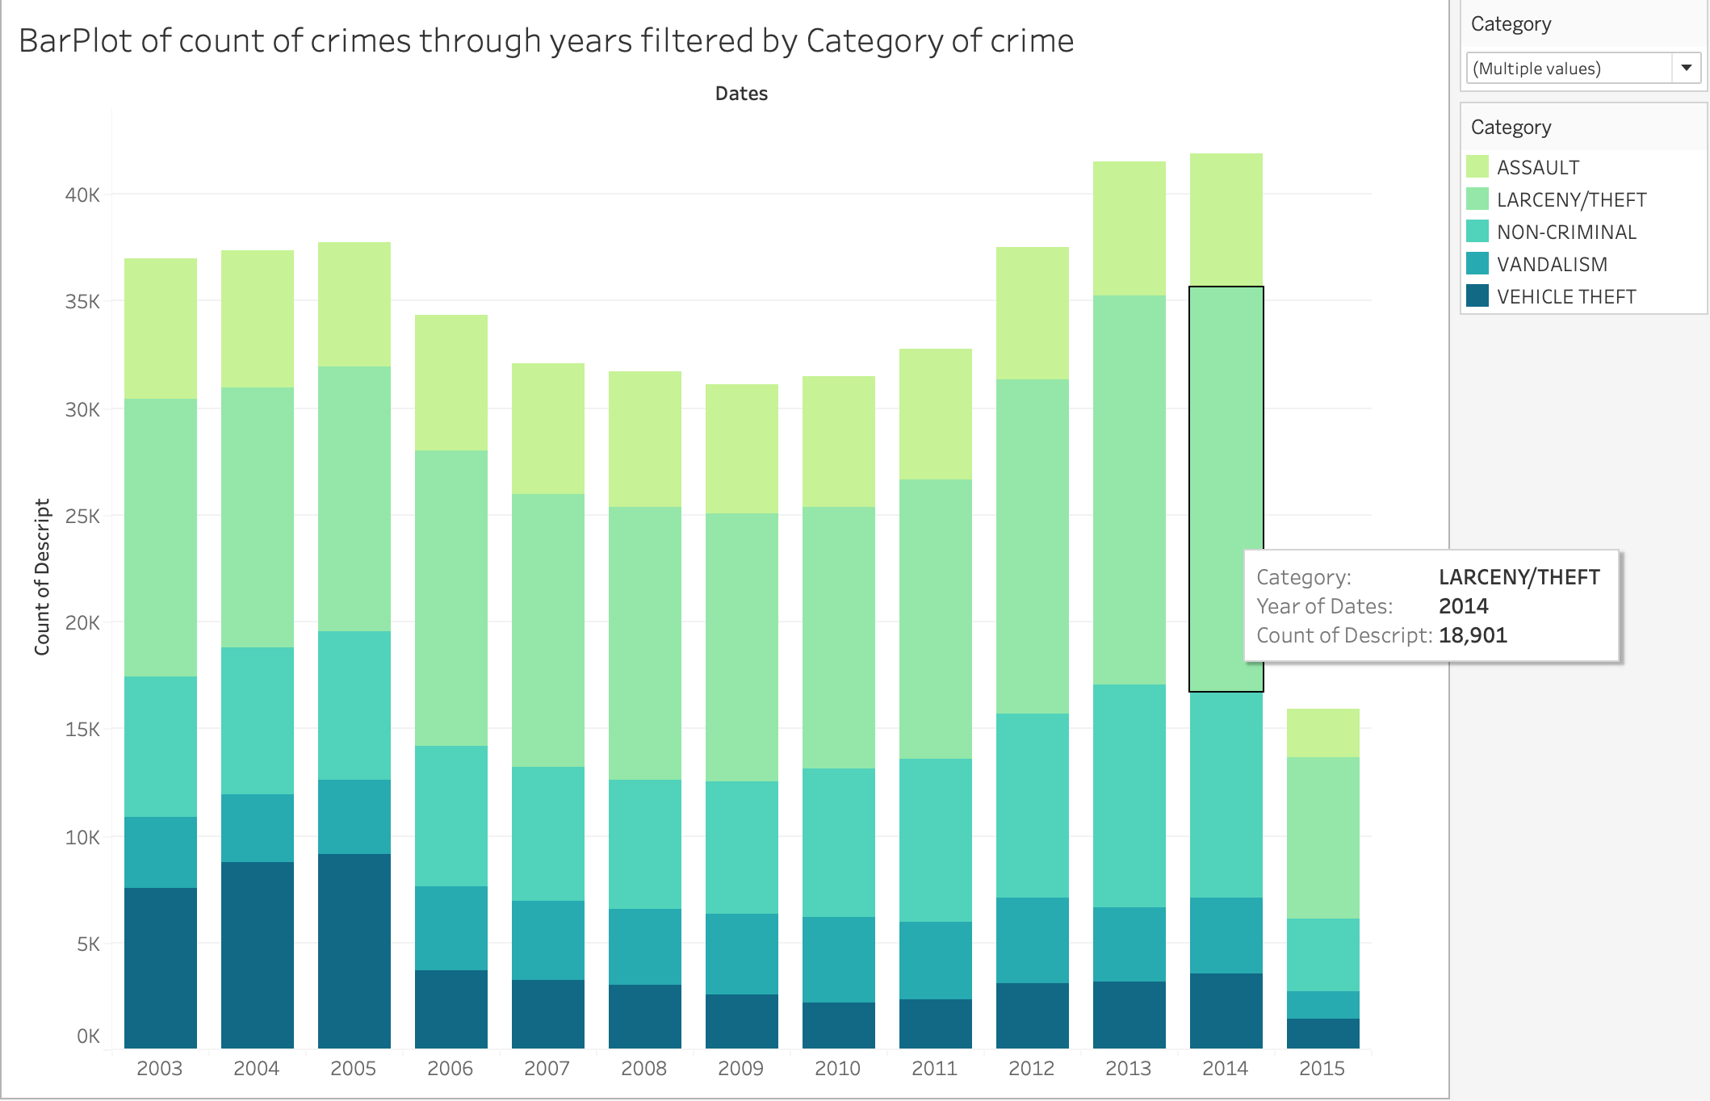
Bar plot of count of crimes through years filtered by Category of crime

Slide 26
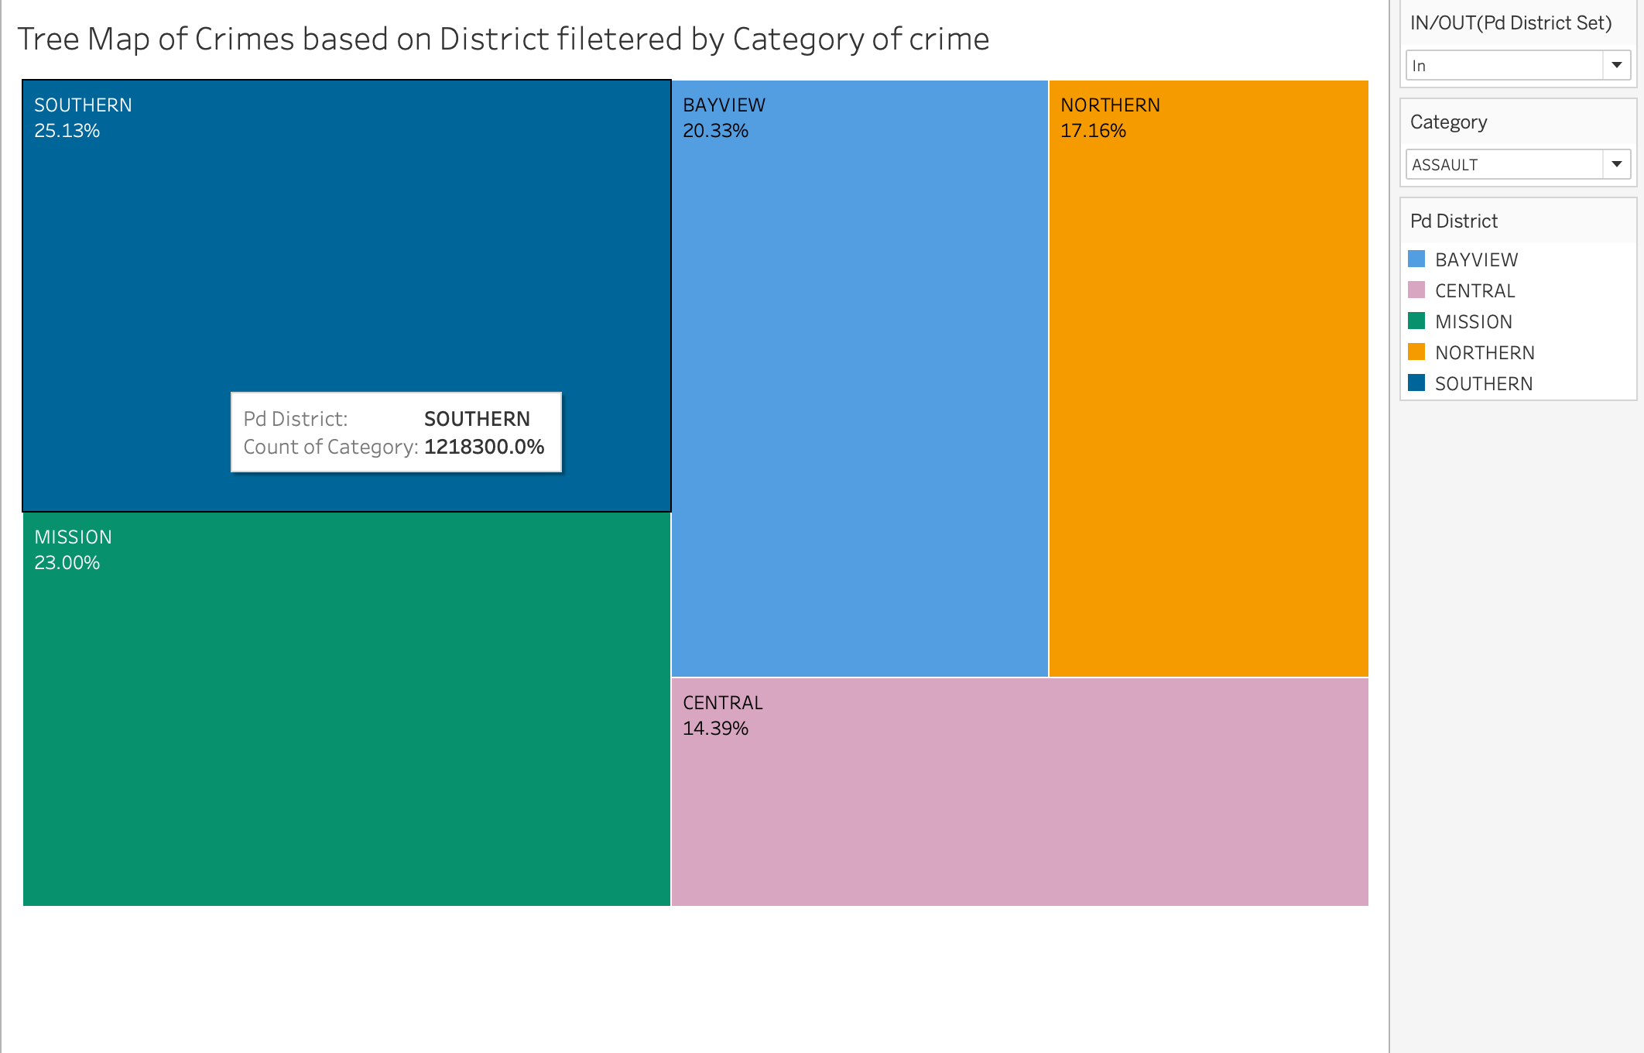
Tree Map of crimes based on district filtered by category

Slide 27
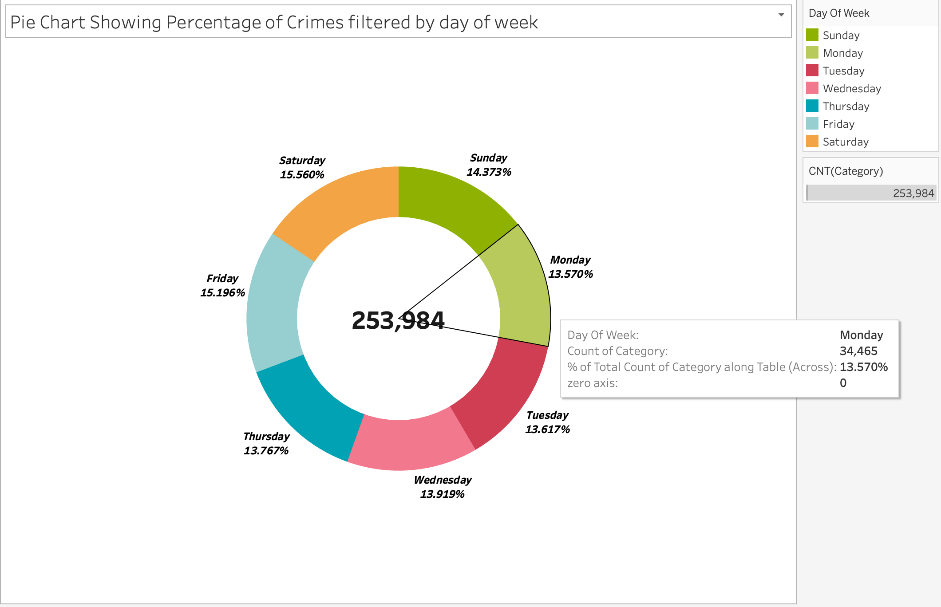
Pie Chart Showing Percentage of Crimes filtered by day of week

Slide 28
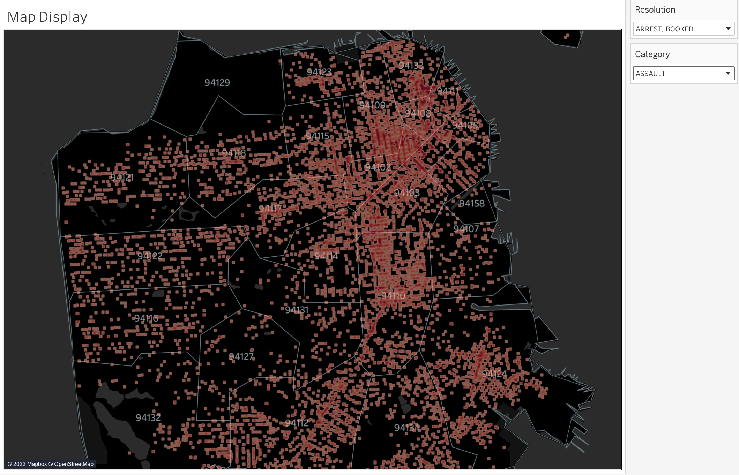
Interactive Map filtered by Category and Resolution

Slide 29
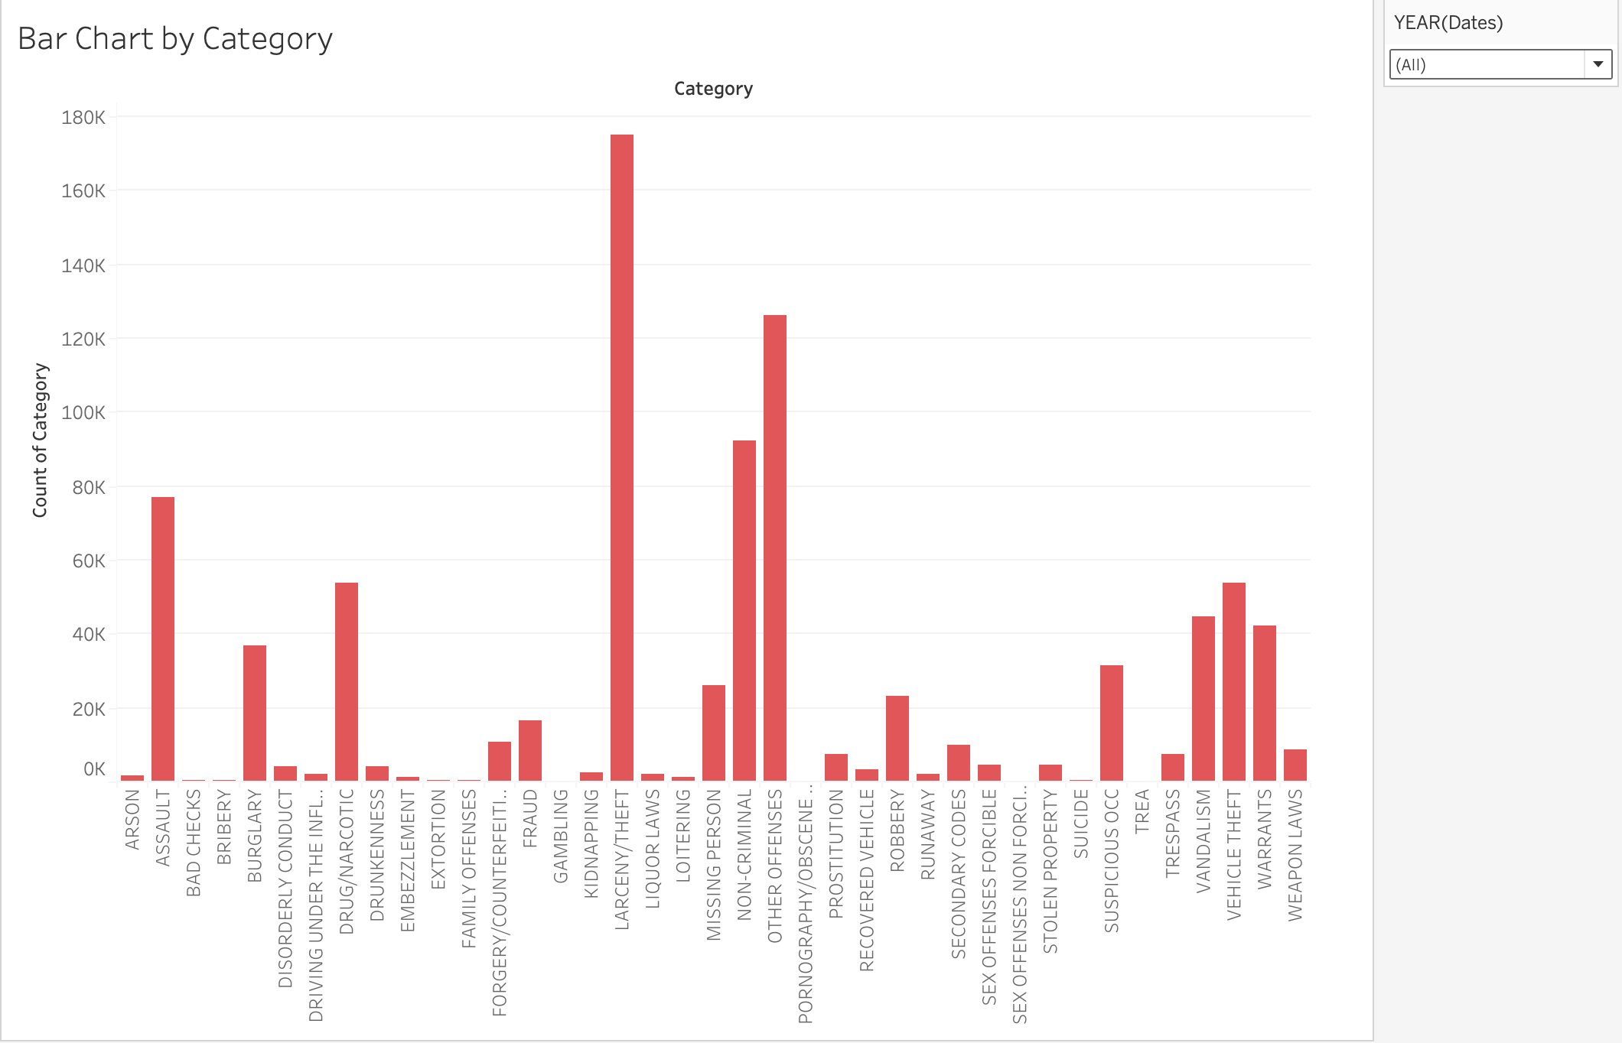
Bar graph by category of crime

Slide 30
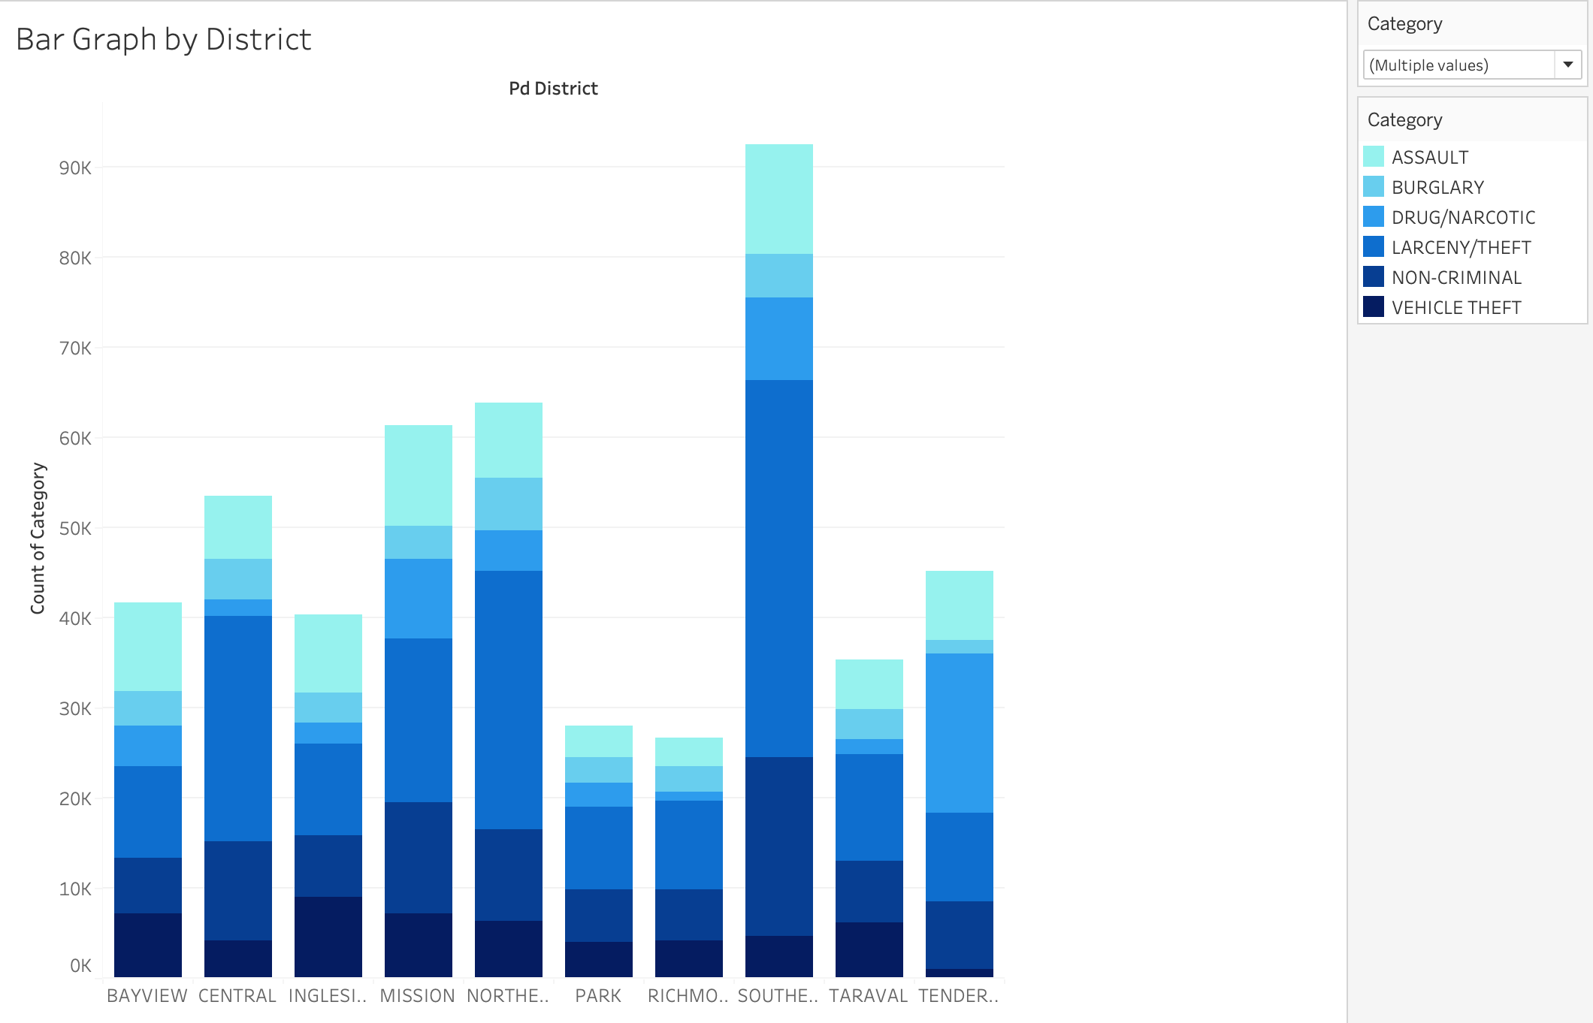
Bar graph by district

Slide 31
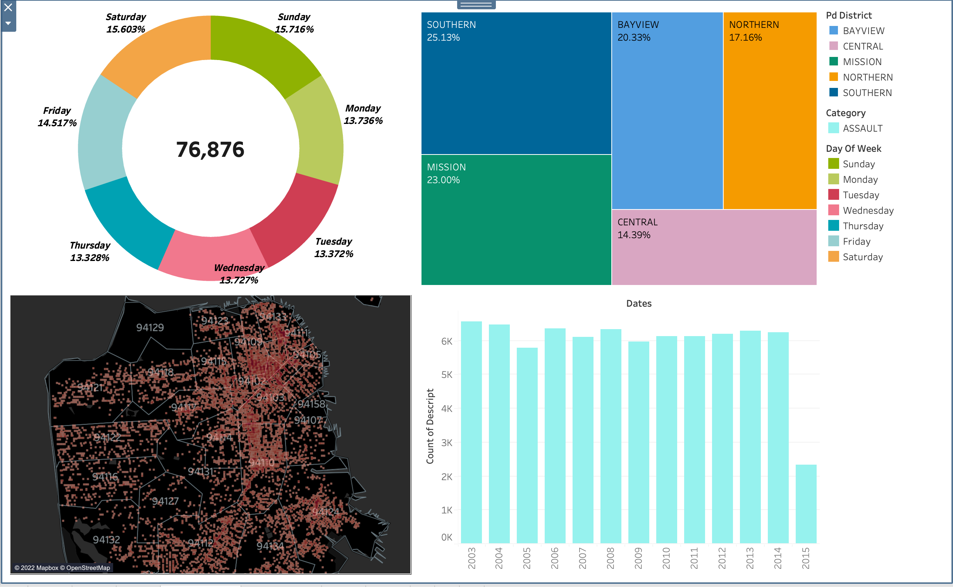
UI Dashboard

Slide 32
Conclusion
The age-old assumption that weekends bear witness to more crimes than the weekdays has been asserted but the margin has been very little as to the expected one.
Comparisons of the area-wise density, district wide count of criminal activities suggest that Southern, Mission areas of the San Francisco were more vulnerable to criminal activities while Central, Bayview had the least susceptibility.
Compared to 2003, the criminal activities have not been consistent where we saw a huge drop during 2010-2011 but saw augmenting during 2013.
Over the years, Larceny/theft has consistently been the category with the highest count of activities.
Most of the criminal activities have not been acted upon i.e., no arrests were made in these cases while some of them are arrested and cited.

Slide 33

Thank you
Team 6

